Slide 1
Heap Sort

Slide 2
When we were studying Priority Queues, we saw that when we sorted a priority queue which was un-ordered, we were doing a selection sort.
When we were working with an ordered priority queue, it was similar to insertion sort.
Now we will try to sort the items on a heap.

Slide 3
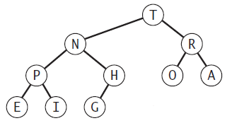
This is a max ordered heap
The largest element is the root.
The parents are larger than their children
The children are smaller than their parent
There is no relation of smaller or larger between siblings.

Slide 4
Sorting using a heap
If we keep performing remove max from a max ordered heap, our output would be sorted in descending order.
But for this to work, we would need to first construct a heap from our given input.
This means we will have the following steps:
1st: To construct a heap
2nd: To remove the max from the heap
3rd: Re-heapifying

Slide 5
We can sort using extra space.
But, as we saw with Quick sort, even though using extra space is possible, we will try to implement it in-place.

Slide 6
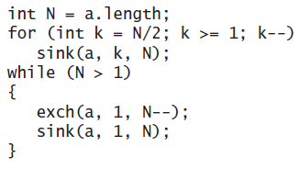
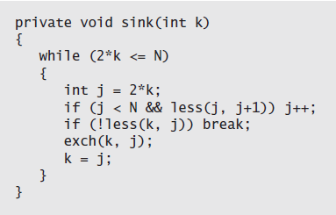
Heap construction
1. Start from N/2 moving from right to left and check max-ordering going from bottom to root.
We start from N/2 because “all nodes with no children are already heap ordered”.
2. Keep exchanging the largest element (root i.e. at position 1) with the element at position N and then calling sink to re-heapify.
Sortdown

Slide 7
6, 5, 3, 1, 8, 7, 2, 4
Construct the Heap
Our heap will look something like this
8, 6, 7, 4, 5, 3, 2, 1
Now, keep performing remove max, keeping heap order intact.

Slide 8
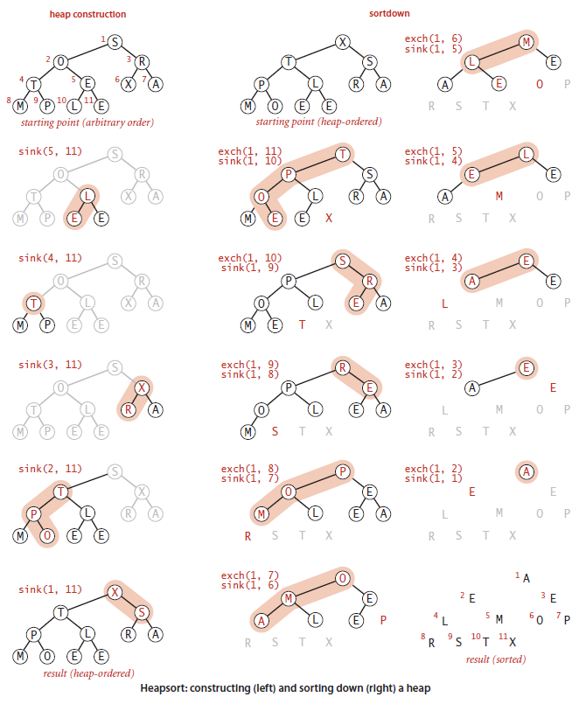

Slide 9
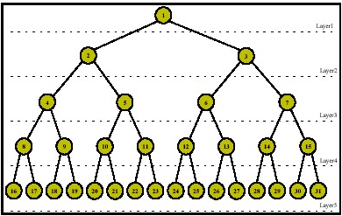
Sink-based heap construction uses fewer than 2N compares and fewer than N exchanges to construct a heap from N items.
E.g. if N=31
No. of Exchanges: At each level, 1 exchange is possible.
No. of Compares: At each level 2 compares are needed.

Slide 10
8 heaps of size 3 (Exchanges 8 x 1, Compares 8 x 2)
4 heaps of size 7 (Exchanges 4 x 2, Compares 4 x 4)
2 heaps of size 15 (Exchanges 2 x 3, Compares 2 x 6)
1 heap of size 31 (Exchanges 1 x 4, Compares 1 x 8)

Slide 11
How long does the construction of the heap take?
How?
Each element has to be taken from the array and placed in the heap i.e. N
Each element needs to be placed so that heap ordering is not violated. That takes logN time.
It needs to compare with each child so 2 N logN

Slide 12
Heapsort uses fewer than 2N lg N + 2N
compares (and half that many exchanges) to sort N items.
The 2 N term covers the cost of heap construction (slide 9).
Heapsort takes 2 N log N. The 2 N logN term follows from bounding the cost of each sink operation during the sortdown by 2log N (previous slide).

Slide 13
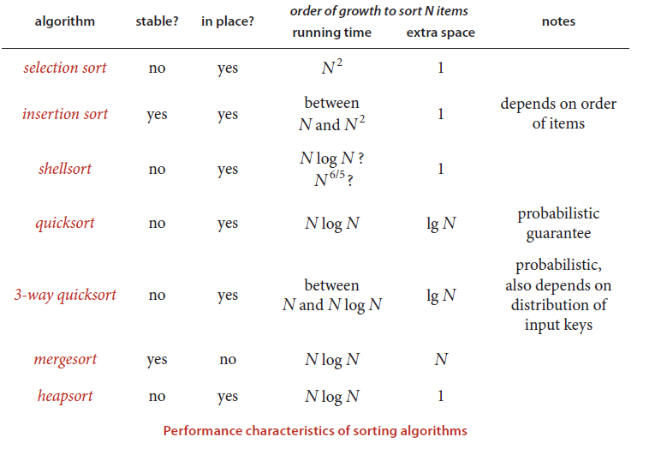

Slide 14

Why not use heap sort rather than Quick sort

